Slide 1


Academy
Computing 101
Anthony McKale
Principal Software Engineer

Slide 2
Agenda
- Computers 101
- Programs 101
- Types of Computer
- Types of Software
- Types of Programming Languages
- Types of Data Format

Slide 3
COMPUTERS 101

Slide 4
Prelude : Big Number Prefix
Computers need big numbers
PS computers unit binary bytes 2^8 1024 not decimal 1000 for storage
Prefix | Size | Prefix | Sizo
Kilobyte | 1,024 | Kilo thousand | 1,000
Megabyte | 1,048,576 = 1024 x 1024 | Mega million | 1,000,000
Gigabyte | 1,073,741,824 | Giga billion | 1,000,000,000
Terabyte | 1,099,511,627,776 | Tera thousand billion | 1,000,000,000,000
Petabyte | 1,125,899,906,842,624 | Peta million billion | 1,000,000,000,000,000
https://en.wikipedia.org/wiki/Metric_prefix

Slide 5
Prelude : Measurement
FLOPS – Floating point operation per second aka a gigaflop is billion floating point operations per second
aka 5 gigaflops = 5 billion a second Storage in bytes – disk space/memory is counted in base 2, not base 10 because CPUs use binary maths, not decimal maths (WAT*)
Networking measured in bytes – because it’s related to uploading / downloading files
https://en.wikipedia.org/wiki/Metric_prefix

Slide 6
What is a Computer ?
Device capable of :
Capable inhuman feats of Mathematics
Follows fixed set of rules, converting inputs into outputs
Unable to deviate from strict rules
Communicates results to operator
https://en.wikipedia.org/wiki/Computer_(occupation)

Slide 7
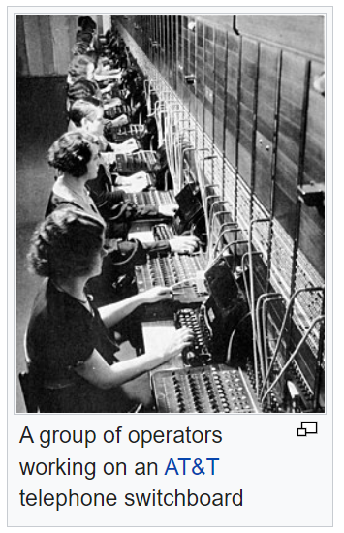
What is a Computer ?
Up until 70 years ago it was in-fact:
well educated and mathematically gifted humans (normally young boys or women)
Working for low pay
Organised into large groups working on broken down problems
https://en.wikipedia.org/wiki/Women_in_computing https://en.wikipedia.org/wiki/Computer_(occupation)

Slide 8
What is a Computer ?
Since then the electronic computer was created Things have gotten faster and cheaper High End Human capable of 0.25 – 1 Flops (Floating point operations per second) iPhone capable of several hundred Gigaflops ~ 800,000,000,000 Flops
electronic computers aren’t just fast thinkers
https://en.wikipedia.org/wiki/Computer

Slide 9
What is a Computer ?
Computer’s Today are a box about 5-6kg, with :
Fast Brain: several billion mathematical operations per second
Huge Memory: able to store every book ever written comfortably*
Fast I/O: Read several million of those books a second
Communication: talk to everywhere on the planet within 1 second

Slide 10
What is a Computer ?
Calculations, in case anyone doesn’t believe it
i9 = 8 cores @ 5 gigahertz = ~40 billion operations a second, 40 gigaflops actually ~1000 gigaflops, multiple queued flops completed each operation!
medium SSD = 1tb = ~ 11 billion books, where book = 100k
SSD = 550mb/s = 5/6 million books a second
Low Cost: about £1-2k

Slide 11
Computer Questions ?
…

Slide 12
COMPUTER COMPONENTS 101

Slide 13
What is a Electronic Computer ?
Computer have millions of parts, but broadly three main component categories :
BRAIN: CPU
GPU MEMORY: RAM Hard Disk
COMMUNICATIONS: Network Card
I/O Devices

Slide 14
Electronic Brains

Slide 15
What is a Electronic Brain ?
BRAINS: CPU central processing unit, brains of the operation
GPU Graphical Processing Unit, Special type of CPU that’s hundreds of times better at 3D graphics than a general purpose CPU

Slide 16
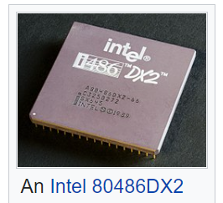
What is a CPU?
CPU important terms:
Clock Speed
number of mathematical operations a second per CPU core, counted in gigahertz (billions per second) CPU Count number of CPUs in a computer 1 low end desktop, 2 high end desktop, 4-64 for high servers
Cores special micro CPU inside a CPU, so if a CPU has 4 cores, then can do 4 things at once, and ~4 times as fast https://en.wikipedia.org/wiki/Central_processing_unit

Slide 17
What is a CPU?
Total Computer Speed Clock Speed x CPU Count x Cores = Speed/second
Dual i9 example (has two 8 Core 5ghz CPUs)
2 x 8 x 5g = 16 x 5g = 80 billion operations a second*
* advanced topic, each core can do many things in parallel inside single operation step, so in reality much higher ! ~ 400 billion, as said advanced topic https://en.wikipedia.org/wiki/Central_processing_unit

Slide 18
Why is my CPU at 25%
Single Thread vs Multi Thread
Thread is the name of a program running on single core of a single CPU
Some programs are multi-threaded meaning they run on multi cores on multiple CPUs Most “modern” programming languages are used in a single threaded manner, to reduce complexity of the programming
Only high performance gamming or computational software are commonly multi-threaded !
486
Top of the line customer CPU, in 1989
50 Mhz (0.05 Ghz)

Slide 19
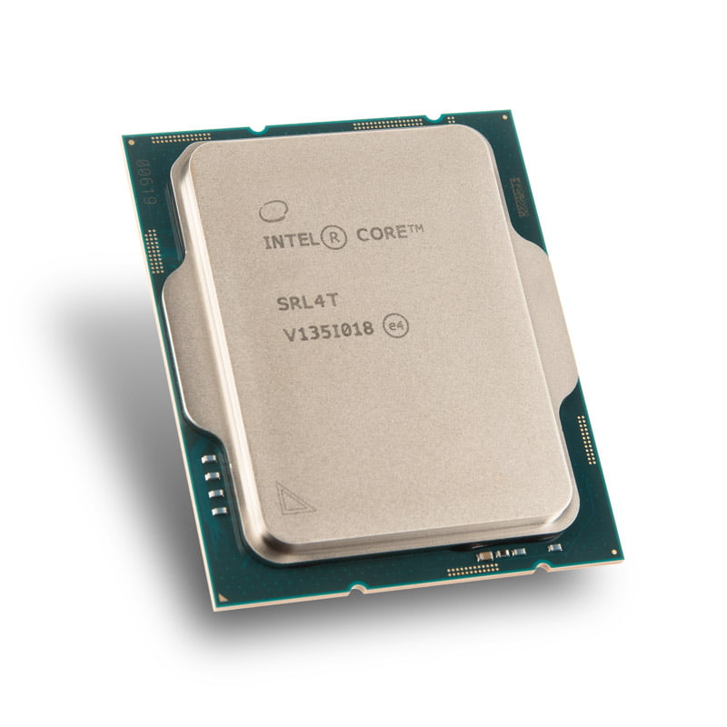
Why is my CPU at 25%
This means most programs don’t get the most out of a computer Unless:
Run multiple copies of program, one on each core
Run program across multiple cores, using specially build Software
i9
Top of the line customer CPU, in 2022
5.2 Ghz

Slide 20
Why isn’t everything multi-threaded !
486: 1989 Top of the line customer CPU
1 Core @ 50 Mhz (0.05 Ghz)
Intel i9: 2022 Top of the line customer CPU
8 Cores @ 5.2 Ghz
2022 i9 Clock speed 104 times faster than 486 from 1989 plus it’s got 8 cores vs 1 core, so roughly 832 times faster

Slide 21
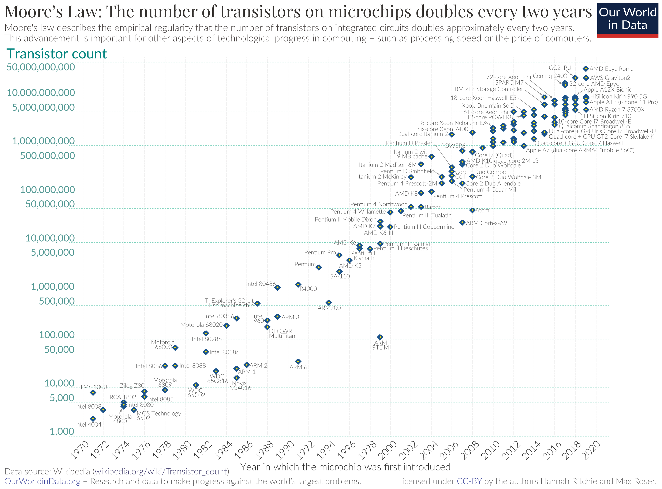
Aside note: Moore’s Law
I9 = 5.2 Ghz 2022
486 = 0.050 Ghz 1989
Clock speed 104 times faster than
486 from 1989 Plus it’s got 8 cores vs 1 core so roughly 832 times faster (2022 - 1989) ^ 2 = 1089 ~ 832
CPUs are doubling in speed* every 2 years since 1965 * speed ~ number of transistors
https://en.wikipedia.org/wiki/Moore%27s_law

Slide 22
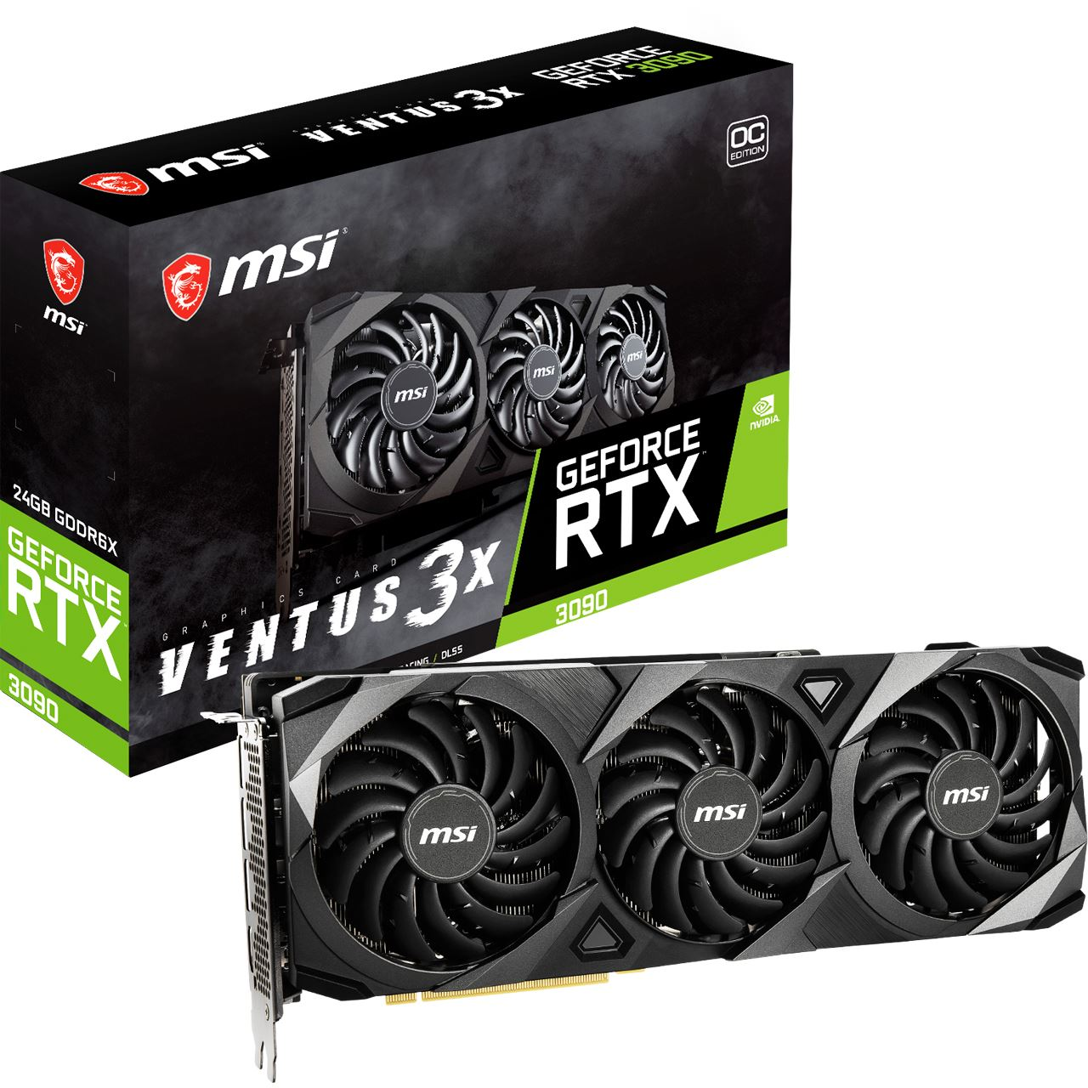
What is a GPU?
GPU is a special CPU for graphics
Advance topic, but just know it’s quality determines the speed of the computer rendering 3D games, and graphics Very often has it’s own private super fast Memory and I/O, and thousands of slow small cores
Why: Graphics is big big data! 4K Screen = 3840 x 2160 pixels x 100 frames per speed = 829,440,000 pixel paint operations a second, just to draw the screen ! https://en.wikipedia.org/wiki/Graphics_processing_unit
RTX 3090 GPU
Top of the line gpu, in 2022

Slide 23
CPU
CPU : computation
GPU : for 3D
YOU CAN GET MORE OUT COMPUTER BY USING ALL THE CORES

Slide 24
CPU Questions ?
…

Slide 25
Electronic Memory

Slide 26
What is a Electronic Memory ?
Memory / Storage
CPU Cache (512kb – 15mb) Super fast memory inside the CPU, for speeding up processing, aka storing data for CPU processing RAM (8gb-16gb) Random Access Memory, the short term memory fast to read and write, disappears when the computer shuts down, aka Program Variables
Hard Disk (1gb-2tb)
Long term storage, slow to read and write to, but able to store much more than RAM, and persistent when the computer shuts down, aka Files

Slide 27
Electronic Memory Terms ?
Latency: amount of time to start accessing a piece of memory
Aka on old hard disks/or DVD drives, the time to move the laser to that part of the disk
Transfer Read/Write Speed: the amount of data per second that can be transferred, often different for writing and reading
Storage Size: total amount of data that can be stored
Volatility: if the data persists if the computer switches off or loses power

Slide 28
Electronic Memory Overview
 | Latency | Transfer | Storage Size | Volatility
CPU Cache | ~1 nanosec | 2.3 tb/s | 256k – 16mb | YES
RAM | ~100 nanosec or ~0.1 microsecs | 25 gb/s | 8gb – 16gb | YES
SSD | ~100 microsec or ~0.1 milisecs | 550 mb/s | 0.5 tb - 1 tb | NO* 5 – 6 years
Hard Disk | ~10-100 milisec | 80 mb/s | 1 tb - 5 tb | NO 20-40 years
Network Drives* | 200-300 milisec | 10 mb/s | Infinite | NO
* https://en.wikipedia.org/wiki/Solid-state_drive#SSD_failure

Slide 29
What is a CPU Cache?
As a developer you will rarely, if at all ever directly accessing CPU cache data, but know it’s there
Every time you add two numbers two together, they were fetched from RAM and placed into the cache ready for the CPU to calculate the result https://en.wikipedia.org/wiki/CPU_cache

Slide 30
What is a RAM ?
Random Access Memory, this is where variables live - SMALL compared to hard drive
- FAST compared to hard drive
- Volatile not for long term storage https://en.wikipedia.org/wiki/Random-access_memory

Slide 31
What is a Hard Drive ?
Hard disk drives, this is where files live - BIG compared to RAM
- SLOW compared to RAM
- Not Volatile file can be stored for many years on hard drives https://en.wikipedia.org/wiki/Hard_disk_drive

Slide 32
What is a HDD vs SSD
Hard disk drives, come in two major types :
SSD : solid state drives, basically special non-volatile RAM - FAST, SMALL, EXPENSIVE, WEARS OUT QUICK HDD : old school spinning disk drive, works like a magnetic DVD drive
- SLOW, BIG, CHEAP, LASTS FOR DECADES https://en.wikipedia.org/wiki/Hard_disk_drive

Slide 33
What happens when you run out of RAM
“Thrashing” is running out of RAM, everything overflows onto HDD. it’s very bad (for program and OS!)
DO NOT USE UP EXCESSIVE RAM, OR YOU WILL CRASH/STALL YOUR APPLICATION (AND THE OS TOO! )
There is a tutorial to prove this later
https://en.wikipedia.org/wiki/Memory_paging#Thrashing

Slide 34
What happens when you run out of RAM
Program variables live in RAM however they can live on a HDD….
“Swapping” is moving in-frequently accessed data onto HDD. it’s normal.
“Thrashing” is running out of RAM, everything overflows onto HDD. it’s very bad (for program and OS!)
https://en.wikipedia.org/wiki/Memory_paging#Thrashing

Slide 35
Memory Questions ?
…

Slide 36
Memory
RAM: for variables, small / super fast / frequent access
SSD / HDD : for files, large / slow / infrequent access
DO NOT USE UP EXCESSIVE RAM !

Slide 37
Memory: File systems
Modern computers, store long-term data on drives
Drives contain containers called folders Folders contain nested folders and binary blobs called files Let’s talk about that binary blob known as a File

Slide 38
File: Encoding
File contain binary data This is often representing human text characters The scheme of mapping binary 0/1 to human character is called File Encoding
It’s a deep subject, here’s a skim

Slide 39
File: Text Encoding
When is text in a file not the same as other text in files Answer : When encoding different
The text is encoded as a binary file, aka in ASCII encoding each character mapping as binary 8-digit number (0-255 byte) ASCII simple encoding table: A-Z a-z characters
https://en.wikipedia.org/wiki/ASCII https://theasciicode.com.ar/
A=65 | B=66 | C=67 | D=68 | E=69 | F=70 | G=71 | H=72 | I=73 | J=74 | K=75 | L=76 | M=77
N=78 | O=79 | P=80 | Q=81 | R=82 | S=83 | T=84 | U=85 | V=86 | W=87 | X=88 | Y=89 | Z=90
a=97 | b=98 | c=99 | d=100 | e=101 | f=102 | g=103 | h=104 | i=105 | j=106 | k=107 | l=108 | m=109
n=110 | o=111 | p=112 | q=113 | r=114 | s=115 | t=116 | u=117 | v=118 | w=119 | x=120 | y=121 | z=122

Slide 40
File: Text Encoding
English and other languages are encoded into 0-1s
Encoding patterns are different across OSes
Common formats:
ISO excellent cross-platform format, old defacto standard pre-web, still in use
UTF excellent cross-platform format, defacto standard for web traffic
Windows-1252 cursed windows format, never use, convert to UTF when detected
If in doubt use UTF-8 it’s the best accepted https://en.wikipedia.org/wiki/ISO/IEC_8859-1 https://en.wikipedia.org/wiki/UTF-8 https://en.wikipedia.org/wiki/Windows-1252

Slide 41
File: Locks (read / write)
Read/Write Access to these “files” is controlled via locks Locks prevent file corruption: file data is lost when you read and write at the same time
Process : - get lock - edit / read file - release lock
Warning: Depending on OS you need to restart the computer when the lock is lost (e.g. program crashes without releasing lock)

Slide 42
File Questions ?
…

Slide 43
I/O

Slide 44
What is a Input / Output ?
INPUT / OUTPUT Network Card
Device that talks to the internet Input / Output Devices
Keyboards, Mice, Trackpads, Cameras, etc
Programming languages have a APIs* for each i/o device * https://en.wikipedia.org/wiki/API

Slide 45
I/O Handling
CPUs are very fast, Memory is fast, I/O is much much slower
It’s hard for very fast CPUs to constantly have to manage slow I/O
Luckily, the CPU is not alone in handling I/O
The devices handling the I/O, have electronics that run small specialist programs called Drivers

Slide 46
I/O Handling
I/O devices (and others) have specialist software called drivers running on them
Drivers and their devices handle common tasks such as:
Sending messages to devices
Receiving messages to devices
Sending notifications to CPU when messages arrive
Devices can even do specialist fast conversion and calculations on behalf of the CPU e.g. video cards can directly convert/send video to the screen

Slide 47
I/O Handling: Reading Warning
Typically I/O is read in three ways Approaches are not equal in efficiency

Slide 48
I/O Handling: Reading Warning
Responses request/wait types: EVENT* / PUSH / INTERUPT : Uses Hardware APIs to be told when a response is ready
Best Approach, least-latency, least-IO/CPU cost
POLL / PULL : regularly check for responses with xxx ms wait in-between
Ok, mid-latency, low-IO/CPU cost Brute force POLL / PULL : Burn CPU cycles constantly checking 100’s of thousands of times a second for a response
Avoid, good-latency, extreme-IO/CPU cost

Slide 49
I/O
Well written software will use devices and their drivers optimally, I/O is hard to make sure to use the best libraries available
Best to check library APIs for a event approach before using polling strategies
Events are built into modern libraries / part of a event driven programming style
Where possible use API events / over frequent polling
NEVER brute force poll !

Slide 50
IO Questions ?
…

Slide 51
Computer Types

Slide 52
Computer Types
Not all environments are the same as Desktops Abstract Environments, are highly restricted in CPU / RAM / HDD
 | CPUs | RAM | HDD
Server | 4-16+ | 16-64gb+ | 10tb+
Desktop | 1-2 | 8-16gb | 1tb
Phone | 1-2 | 2-6gb | 64-128gb
Cloud EC2 | 1 | 4gb | 1tb
Cloud Lambda | 1 | 128mb | -
VM running in Server | 1 | 256mb | 100mb
Youview Set-top box | 1 | 32mb Kummerspeck… :’( | 1tb

Slide 53
Computer Types
Physical :
Mini+ Computers : Servers / Super Computers
Micro Computers : Desktops / Laptops
Nano Computers : Mobiles / IoT devices / Embedded Devices
Abstract :
Cloud compute : remote container/VM computers
VM: virtual computer running on a physical computer

Slide 54
Computer Types
NOT all computers are equal
Develop software for the type of computer, NOT just your development laptop!
NEVER waste RAM or CPU!
ESPECIALLY RAM !

Slide 55
Computer Type Questions ?
…

Slide 56
Types of Software (Recap)

Slide 57
Software Types
Background services – no user input, runs in background
CLI software – simple text input, can run in background
UI software – has pretty user UI, can not run in background (often just pretty frontend to Background service or CLI)
Terminal Software – simple text input, but nothing happens locally, all I/O sent to remote server (comes in two parts Server / Client)
Web Software – special terminal software, html UI application sent from Server, ran on HTML client (lots of implementation, but all follow HTML protocol for sending data/app back and forth)

Slide 58
Software Types
 | User Interface | Processing
Background service | None | Local
CLI software | Text CLI | Local
UI Software | Windowed Application | Local
Terminal Software | Text CLI | Remote
Web Software | HTML Application | Local / Remote
Desktop users tend to only explicitly run UI / Web (client) Software
Servers tend to run only run service / CLI / Web (server) Software
Choose software type based on your customer (Desktop or Service)

Slide 59
Software Type Questions ?
…

Slide 60
Types of Programming Language

Slide 61
Programming Languages
Category of Language How the code is ran, any compilation, interpreters, or engines
Type of Language How the code is written, any abstractions away from devices / hardware

Slide 62
Programming Languages
Category of Language How the code is ran, any compilation, interpreters, or engines
4 Major Types

Slide 63
Categories of Language (1/2)
Machine / Assembly languages list of actual CPU instructions (or for Assembly the human readable version)
Each GPU / CPU type has it’s own language
High Level Languages Written in strictly syntaxes pseudo English, able to express actions that are “assembled/compiled” into Machine language, now considered low-ish
(rust / C++ / ML / compiled-Python)
Scripting Languages
Written in strictly syntaxes pseudo English, able to express actions that are run in an interpreter than outputs Machine language, can be compiled for speed
( javascript / python / PHP / Bash / VBa )

Slide 64
Categories of Language (2/2)
VM byte code languages Written in strictly syntaxes pseudo English, able to express actions that are compiled into a common format, that can be run in a Virtual Machine
(Java / node) * node == javascript + Node Virtual Machine https://en.wikipedia.org/wiki/Node.js

Slide 65
Programming Languages
Type of Language How the code is written, any abstractions away from devices / hardware
6 Major Types

Slide 66
Types of Language
Expressing instructions is hard
Controlling Ordering/Flow in programs is hard (especially async / parallel programming!)
Expressing and manipulating data is hard
Scripting / High Level Languages
Unsurprisingly several competing approaches exist

Slide 67
6 Types of Language (1/3)
Imperative Languages
Follows a list of commands, with unrestricted jumping to code line for control flow, pure computing at it’s best, or spaghetti in the wrong hands…
Procedural Languages
Imperative Language with safety rails, aka no raw GOTOs, if / for / while etc
Logic based Languages
Arranged around mathematical proofs and notation, excellent for proofing formulas, not great at UI

Slide 68
6 Types of Language (2/3)
Functional Languages
Arranged around efficient nested functions
pure functions that only have inputs and outputs no side effects
Every input has a deterministic output
spreadsheet formulas common example of functional programming language
Object-oriented Languages
Arranged around abstract ideas about data being of a human type of thing (rather than raw 0-1s or floating data types) Attempts to make data easier to understand and more human

Slide 69
6 Types of Language (3/3)
Modern Languages
Most modern languages are pragmatic OO, containing features of all the pure languages that followed Programmers can write in the other styles of language Often to take advantage of the strengths of that style

Slide 70
Modern Languages: Terminology*
There is over lap in terminology
Modern languages cover multiple language types, as such language types can be used to describe programming style aka there is Functional Language Type, but in a modern language you can program in a functional style there is a Scripting language category, but in a modern language you can you can write in a scripting style (which ironically is similar to a Imperative Language)

Slide 71
Modern Languages: Functional Example
Aka lambda functions are in node (modern language) which is beautifully tight / self-contained, can be used to write code in a Functional programming style
# functional node
let addOne = (a) => a + 1 # non functional node let addOne = function (a) { return a + 1 }

Slide 72
Language Questions ?
…

Slide 73
Computing: Overview
The world is a complex place, full of terrors
Choose the right tools for the right job

Slide 74
Questions
I’ve been Anthony “Zapper” M^{c}Kale
Hopefully I’ve Educated, Informed, and even Entertained Good Testing is Good Security is Good software

Slide 75
Thank you

